Slide 1



Nordic Probabilistic AI School

Slide 2
Welcome to Nordic ProbAI 2024
Andrés R. Masegosa
General Chair

Slide 3
Sponsors

Slide 4



Supporters

Slide 5
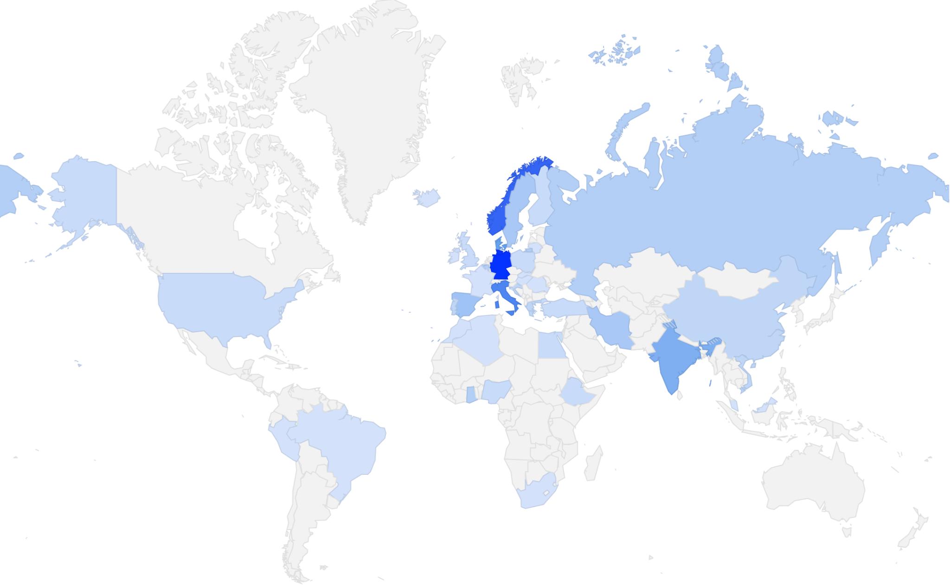
Participation
811 applicants
146 registrants
[18% acceptance]
37 nationalities
168 participants
Notes:
811 applicants
146 registrants (students, 18 %)
37 nationalities (students only)
168 participants (incl. lecturers, TAs, organizing team)

Slide 6
Code of Conduct
We aim for diversity, inclusion, openness, collaboration, and knowledge sharing.
Be welcoming and supportive.
Be respectful and keep a good tone.
Collaborate and share knowledge.
Respect personal boundaries.
https://nordic.probabilistic.ai/attendance (has a link for reporting misconduct)

Slide 7

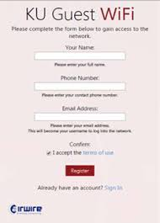
Wi-Fi
Use eduroam if you have access
Otherwise use KU-Guest

Slide 8
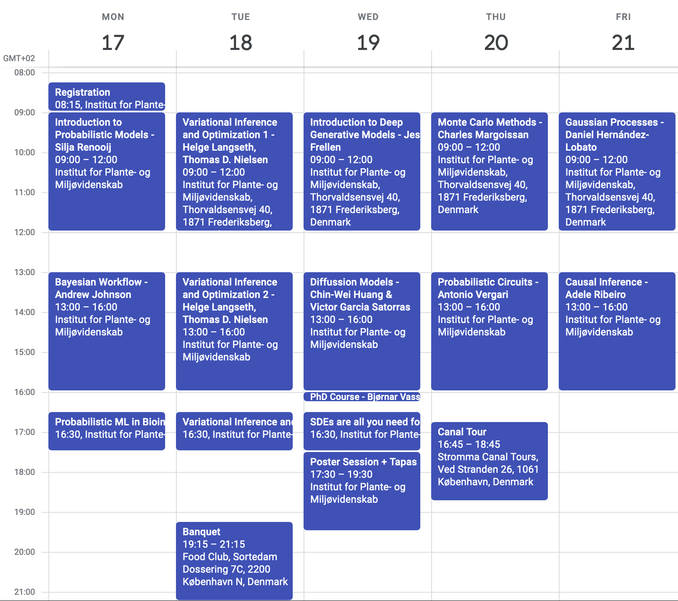
Program
On the website
Kept up-to-date
Busy Schedule

Slide 9
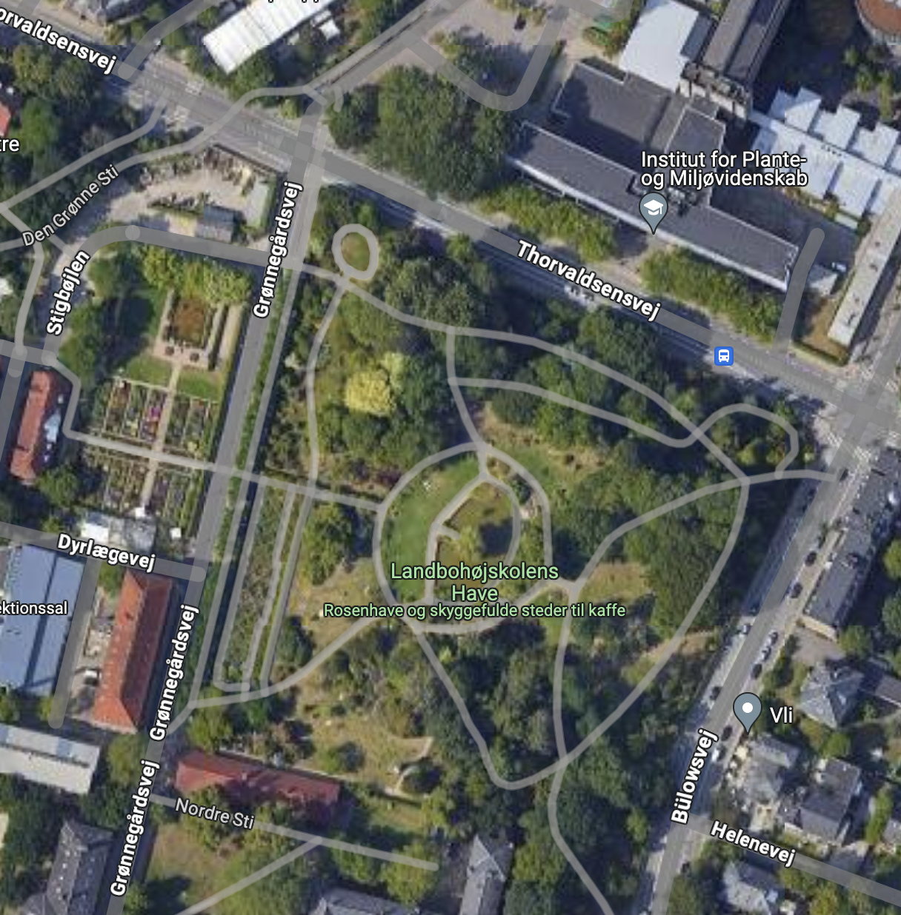
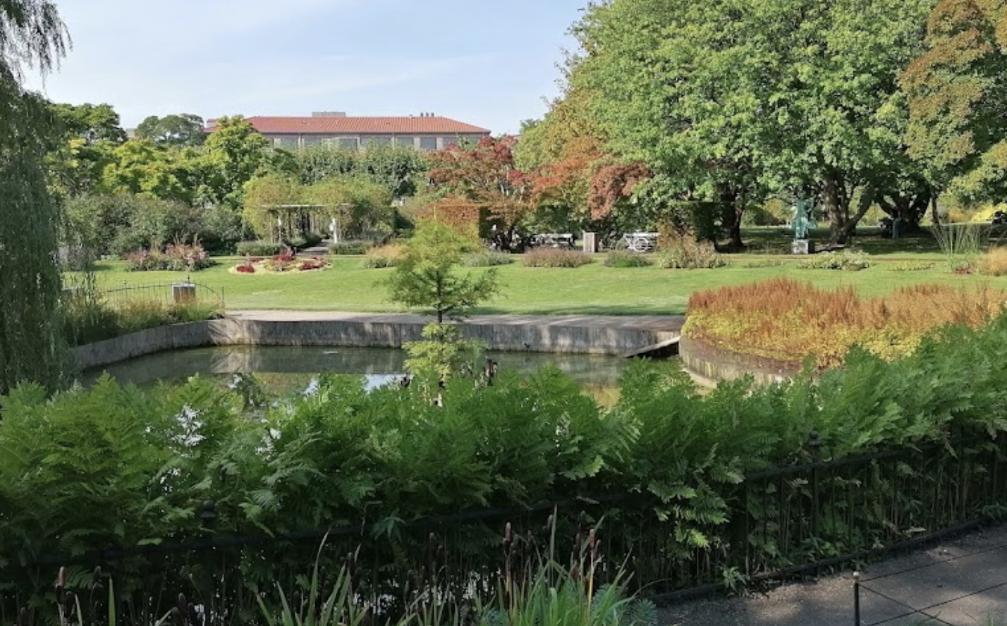
Lunch & Coffee Breaks
Served in the common area
Coffee Breaks:
8.30am - Coffee and Tea
10.15am - Coffee, Tea + Fruit.
14.15am - Coffee, Tea + Cake of the day.
Lunch:
12pm-1pm
Bagels, Bowls and Sandwiches.
Enjoy your lunch at the parks next to the venue.
In front of the main entrance.

Slide 10
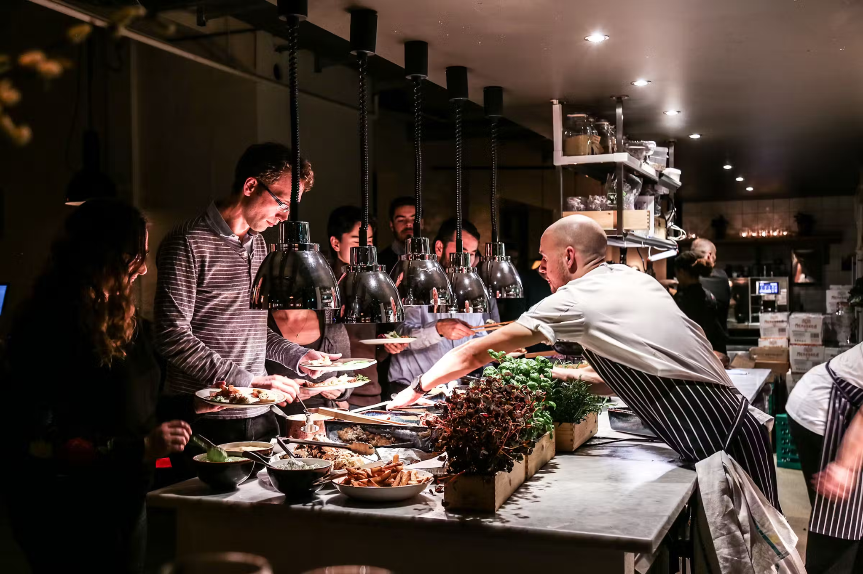
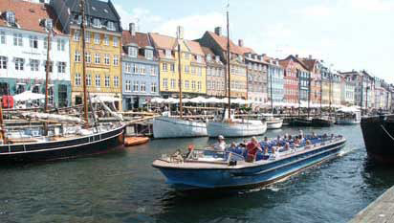
Social Program
Tuesday (7.15pm) - Banquet Dinner
Details in the Program
Wednesday (5.30pm) - Poster Session
Tapas & Drinks will be served
Thursday (4.45pm) - Canal Tour
Details next slide

Slide 11
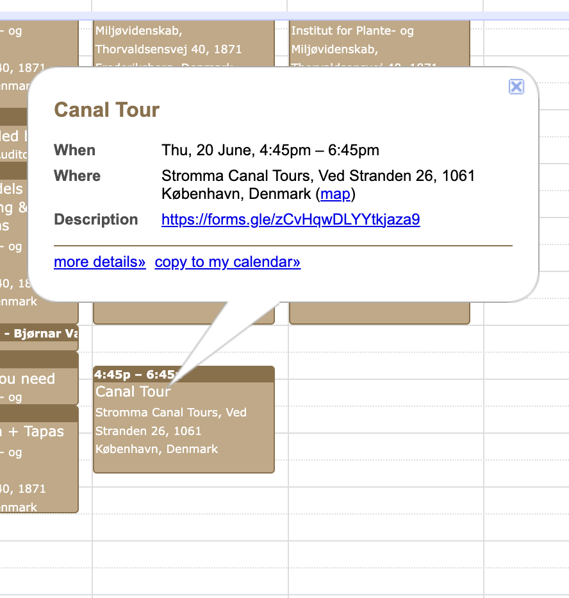
Canal Tour
Only 130 spots available
Randomly selected
Link to register on the program
https://nordic.probabilistic.ai/program/
Deadline: Today, 11.59pm.
Notifications by email tomorrow.
Leaving at 4.10pm from the main entrance.
Travel by Metro.
20 mins trip.
Tour starts at 4.45pm.

Slide 12
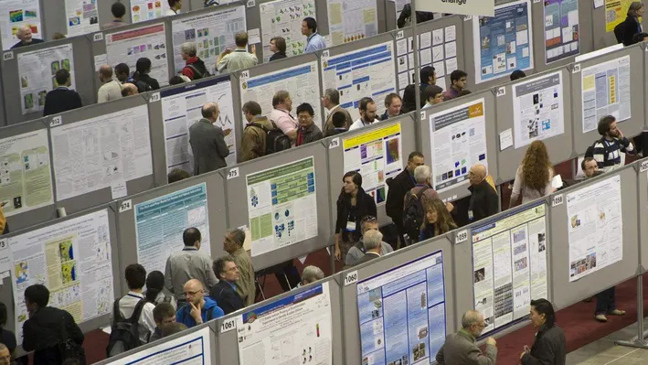
Poster Session
When?
Wednesday 5.30pm
Where?
Common Area outside Auditorium
Posters can be hang on the walls
We will provide putty.
Printed Posters will be delivered today.

Slide 13
Email
hello@probabilistic.ai

Slide 14
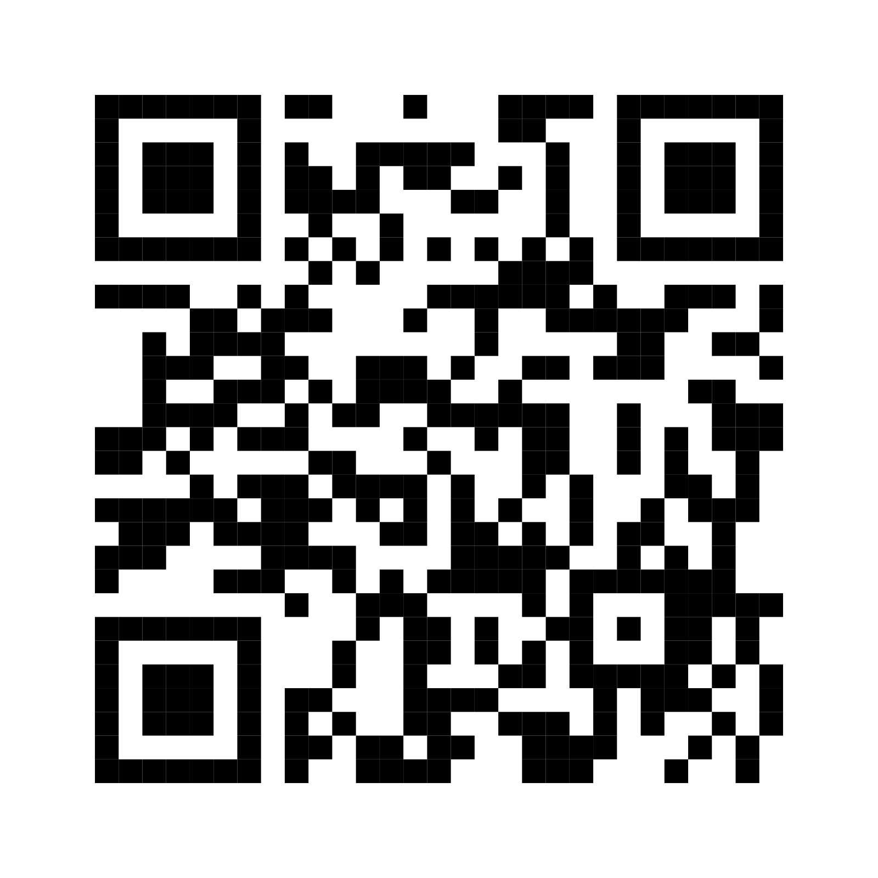
Slack
https://nordic.probabilistic.ai/join-slack-2024
Notes:
For event-related backchannel communication.

Slide 15
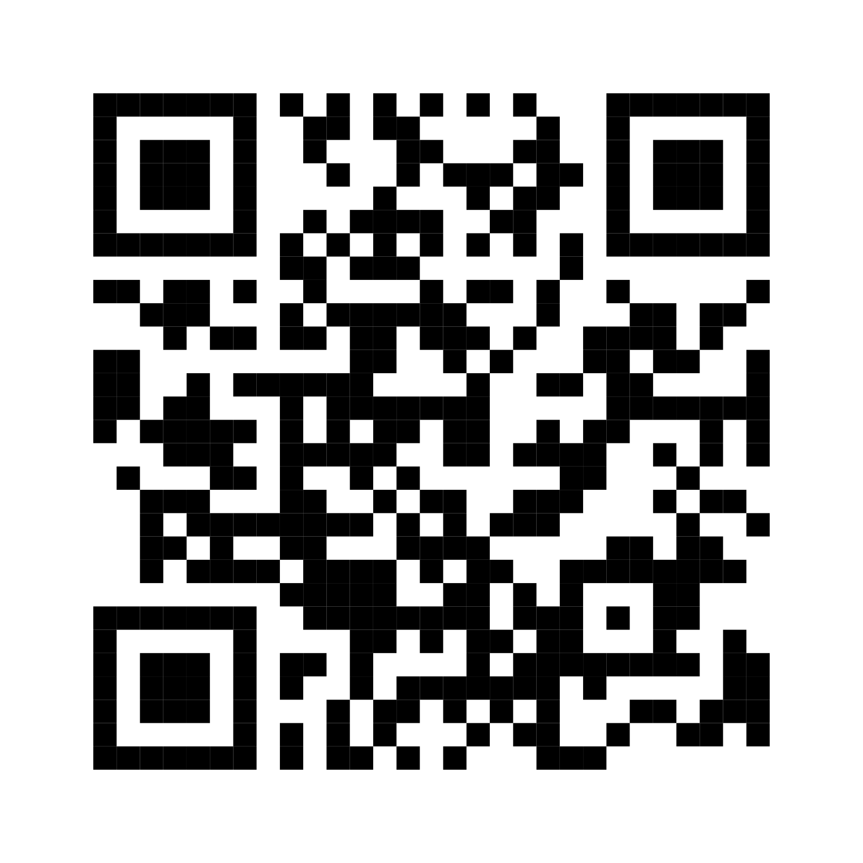
WhatsApp
https://nordic.probabilistic.ai/join-whatsapp-2024
Notes:
WhatsApp group for informal communication. You can use it to connect with fellow participants, for example, to coordinate meet-ups and other activities

Slide 16
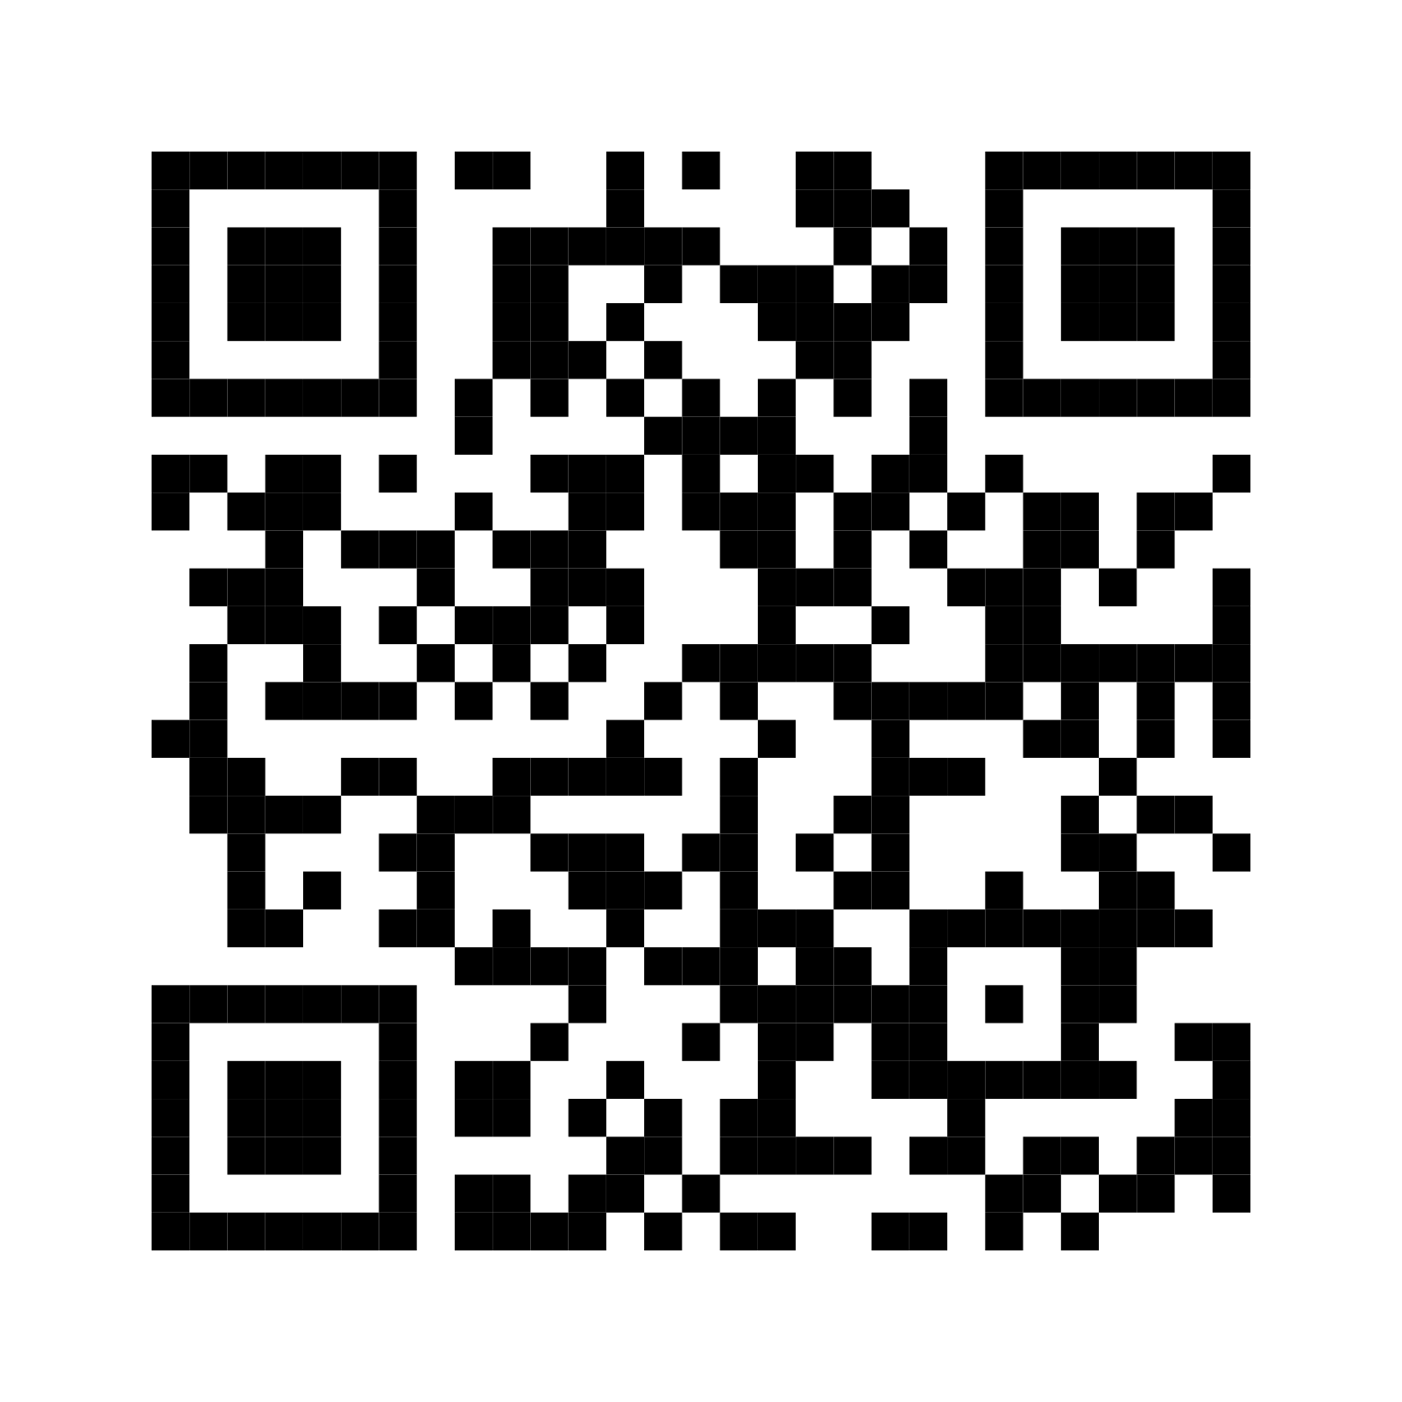
Slides & Materials & Recordings
https://github.com/probabilisticai/nordic-probai-2024

Slide 17
Share your experience!
#probai
@probabilisticai
Notes:
We encourage you all to share on social media (especially Twitter/X) your thoughts, highlights, memorable moments or just report on what’s happening. Your posts may be featured on our channels.

Slide 18
Recording & Photography
Lectures are recorded and will be shared with the public.
Event will be photographed. Photographs used for reporting (incl. Social media) and possibly promotion.
Please report to organizers if you do not wish to appear on recordings and photographs, and please, proactively try to avoid exposure.
Group photo on Wednesday.

Slide 19
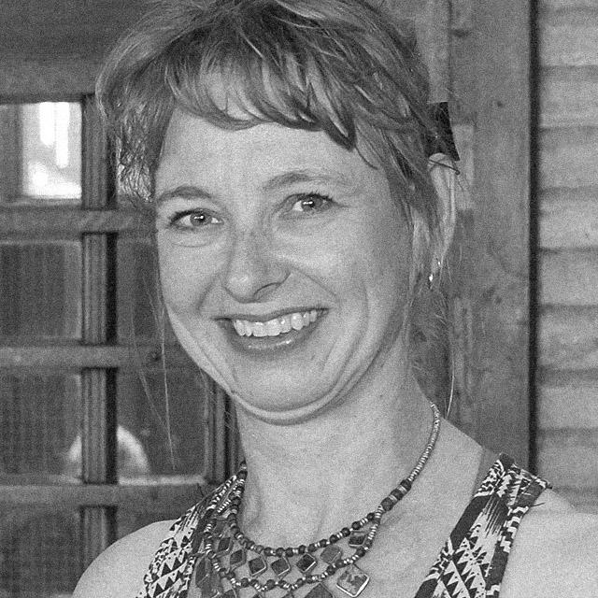
First speaker: Silja Renooij, “Introduction to Probabilistic Models”

